Slide 1


Unfair and Illegal Discrimination in AI
PRABAL GHOSH
Université Côte d'Azur

Slide 2
Table of Content
Introduction
Cases of AI-Enabled Discrimination
Case 1: Gender Bias in Recruitment Tools
Case 2: Discriminatory Use of AI in Law Enforcement and Predictive Policing
Case 3: Discrimination on the Basis of Skin Colour
Challenges in Addressing Discrimination
Responses to Unfair/Illegal Discrimination
AI Impact Assessment
Ethics by Design
References

Slide 3
Introduction
AI systems can include biases and lead to unfair and illegal discrimination against individuals on the basis of protected characteristics, such as age, race, gender and disability.
AI systems often analyse data collected for different purposes without considering properties that may lead to unfair discrimination.
AI system encounters real-world data that significantly different from its training data, it may struggle to process the new data accurately.

Slide 4
Cases of AI-Enabled Discrimination
Highlighting three significant cases:
Case 1: Gender Bias in Recruitment Tools
Case 2: Discriminatory Use of AI in Law Enforcement and Predictive Policing
Case 3: Discrimination on the Basis of Skin Colour

Slide 5
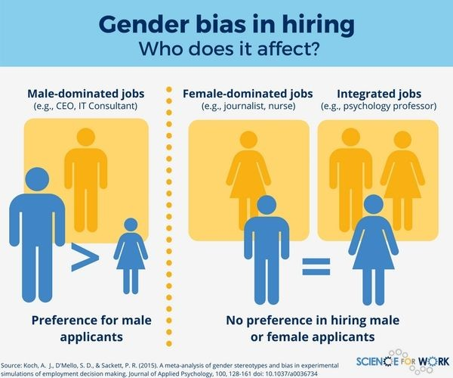
Case 1 - Gender Bias in Recruitment Tools
Recruitment is a crucial aspect for organizations, demanding time and resources.
It requires organisations to scrutinise job applications and CVs(non-standardised, complex documents).
Recruitment was an early candidate for automation by machine learning
Amazon's AI Recruitment tool shows the gender bias.

Slide 6

Amazon's AI Recruitment Challenge
Amazon's Approach:
2014 develop an AI program to automate candidate selection.
Gender Discrimination:
AI tool, trained on data from the past 10 years, exhibited bias against female applicants.
Even after removing direct identifiers (sex ) it was biased.
AI found proxy variables that still pointed to gender, such as place of study and feminised hobbies
The model was penalized for language like 'women’s chess club captain.
Efforts to modify the system failed; Amazon abandoned AI in hiring (2015).

Slide 7
Case 2 - Discriminatory Use of AI in Law Enforcement and Predictive Policing…
Glenn Rodríguez's case:
16-year-old arrested for armed robbery.
Denied parole based on AI system's risk prediction(high-risk prediction by the COMPAS ).
Lack of transparency in AI algorithms used in criminal justice.
The parole board had no insight into how the COMPAS risk score was calculated, as it was considered a trade secret.
Score was influenced by subjective views of prison guards

Slide 8
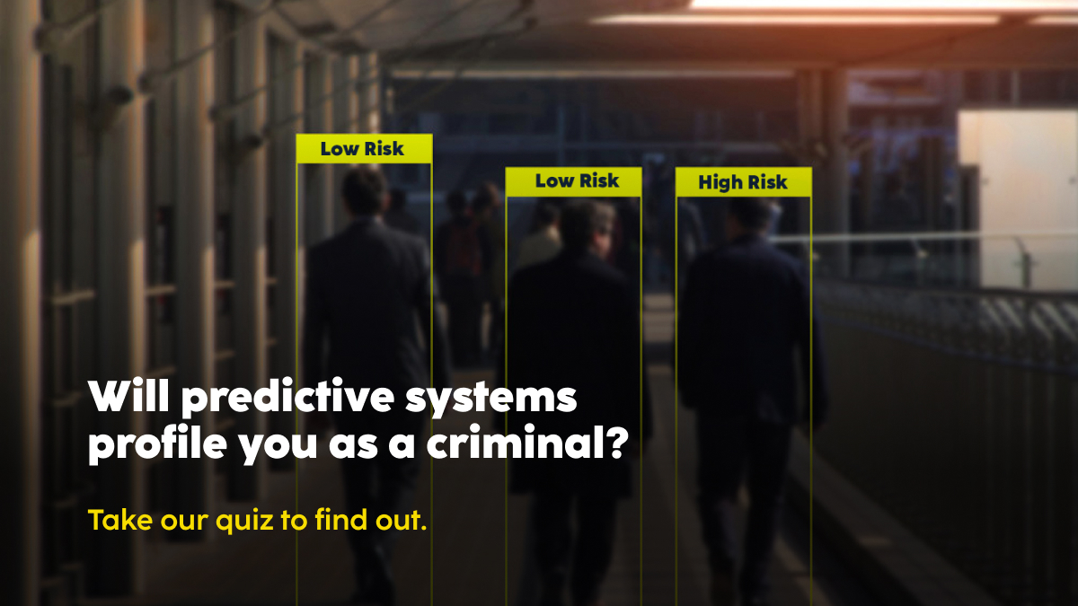
Case 2 - Discriminatory Use of AI in Law Enforcement and Predictive Policing
Predictive Policing:
Predictive policing uses past crime data to detect patterns suitable for extrapolation into the future, to help police to identify locations and time of crime
The use of past crime data means that historical patterns are reproduced.
Predictive policing tools may unfairly target individuals in deprived areas regardless of personal involvement in crimes. Discrimination based on residential location.
Implementation in various jurisdictions (US, UK, China, India, Germany etc.).

Slide 9
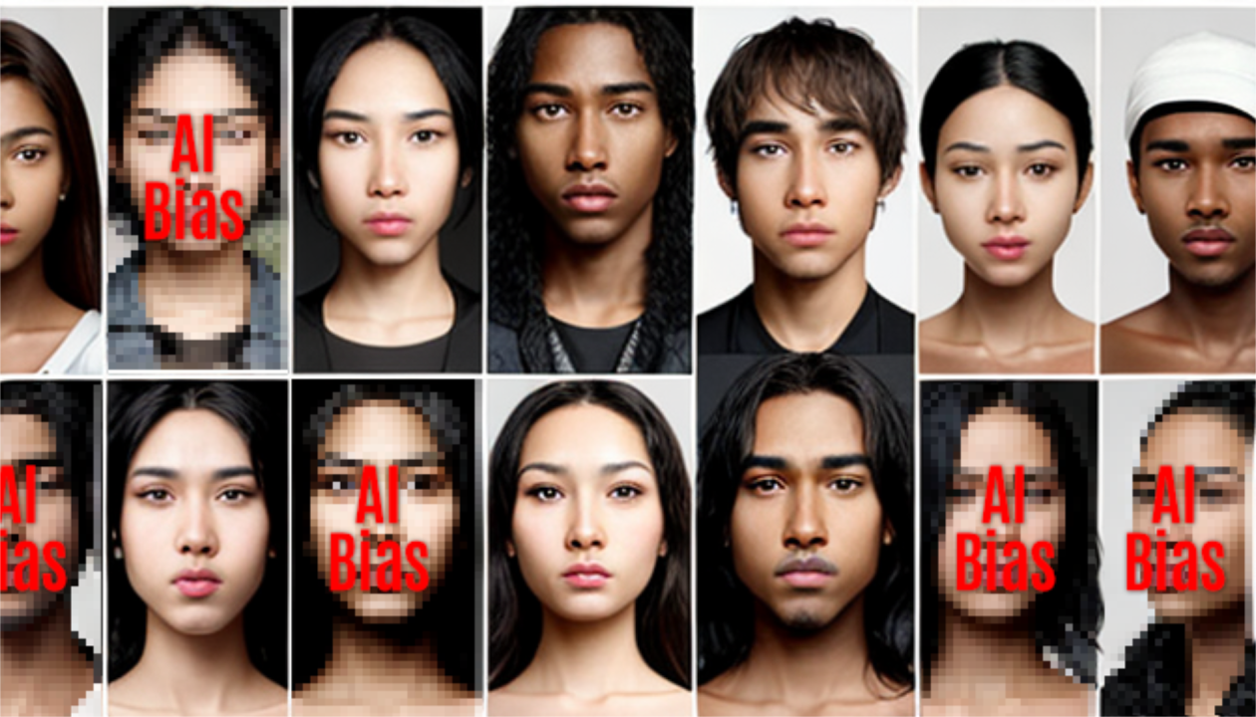
Case 3 - Discrimination on the Basis of Skin Colour
Passport Photo Rejections based on ethnicity :
New Zealand case: Asian student rejected due to alleged closed eyes.
UK instances: Dark-skinned women facing higher rates of poor photo quality assessments.
Most image classification often trained on datasets like ImageNet.
Over-representation and under-representation in training sets contribute to biased outcomes.

Slide 10
Challenges in Addressing Discrimination
Training Data Challenges:
Difficulty in remove biases in training data.
Inclusion of biases from historical discriminatory processes.
Limited Alternative Datasets:
Lack of alternative datasets, especially in law enforcement and criminal justice.
Discrimination For Recruitment and criminal justice:
Cases the biases were introduced by the systems involved in creating the data.
Discrimination Based on Skin Color:
Due to inadequate representation in datasets.

Slide 11
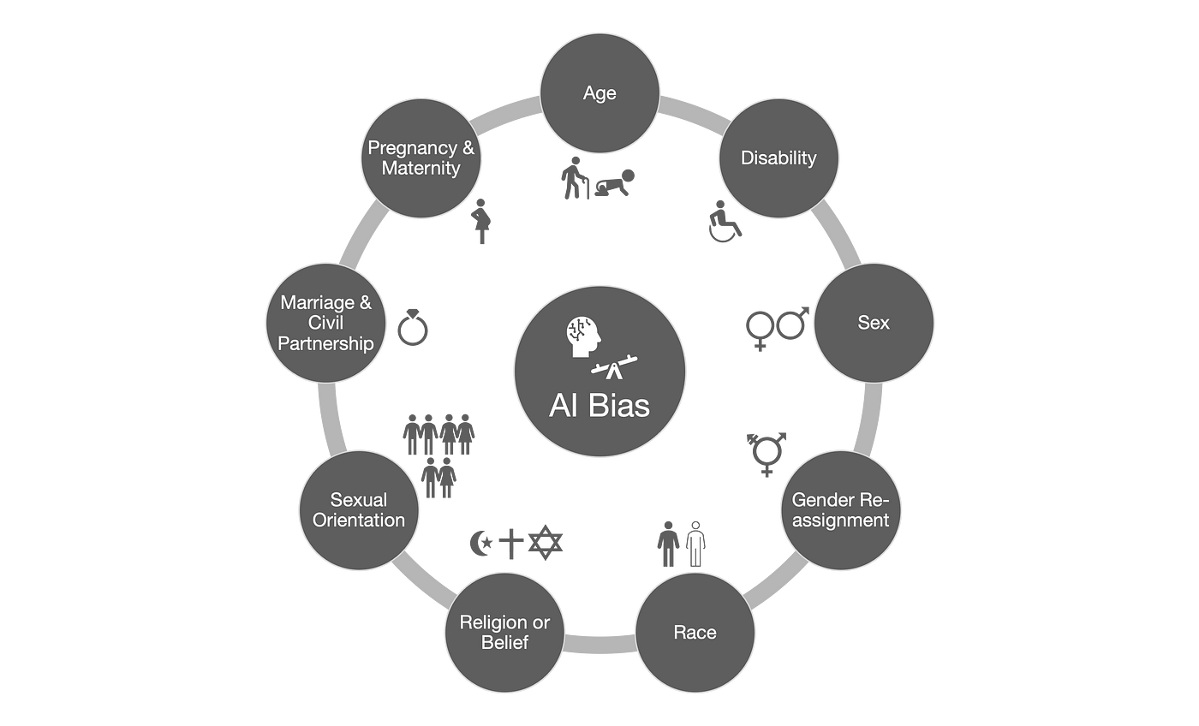
Ethical and Legal Dimensions of Discrimination
Protected Characteristics:
Legal protection against discrimination based on specific characteristics. Ex- race,sex…
Intersectionality:
Challenges in identifying multiple characteristics (intersectionality) in discrimination.
In this case it may be impossible to determine which characteristic led to the discrimination. Ex - person who is discriminated against is a black, disabled, working-class woman.

Slide 12
Responses to Unfair/Illegal Discrimination
The European Commission’s proposed regulation forAI. example, stipulates that “training, validation and testing data sets shall be relevant, representative, free of errors and complete” (European Commission 2021: art. 10(3)).
Difficult to meet such data quality requirements with real-life data.
Overview of responses:
AI Impact Assessment
Ethics by Design

Slide 13
AI Impact Assessment
Purpose:
Identifying possible ethical issues early.
Use this understanding to prepare mitigation measures.
Examples of impact assessment
European Commission's AI HLEG, IEEE's recommended practice.

Slide 14
AI Impact Assessment
The discussion of what such an AI impact assessment should look like in detail is ongoing.
Different impact assessment bodies named as the European Data Protection Supervisor (EDPS 2020), UNESCO (2020), the European Fundamental Rights Agency (FRA 2020), and the UK AI Council (2021).
An AI impact assessment is therefore likely to be a good way of raising awareness of the possibility and likelihood that an AI system may raise concerns about unfair/illegal discrimination.

Slide 15
Ethics by Design
Concept of Ethics by Design:
The concept of ethics by design was developed by Philip Brey and his collaborators (Brey and Dainow 2020)
Focus on embedding ethical values in AI design and development.
Affected Values :
Human agency, privacy, fairness, wellbeing, accountability, transparency.
The value of fairness is key to addressing questions of bias and unfair/illegal discrimination.
Implementation:
Integrating ethical values into different design phases.
Linking ethical concerns with systems development methodologies.

Slide 16
Conclusion
The complexity of addressing bias and discrimination in AI.
Potential of ethics by design in integrating ethical values into AI development.
Continuous efforts needed to ensure fair, unbiased, and ethical AI outcomes.

Slide 17
References
Ethics of Artificial Intelligence Case Studies and Options for Addressing Ethical Challenges.
https://link.springer.com/book/10.1007/978-3-031-17040-9

Slide 18
THANK YOU

